Slide 1
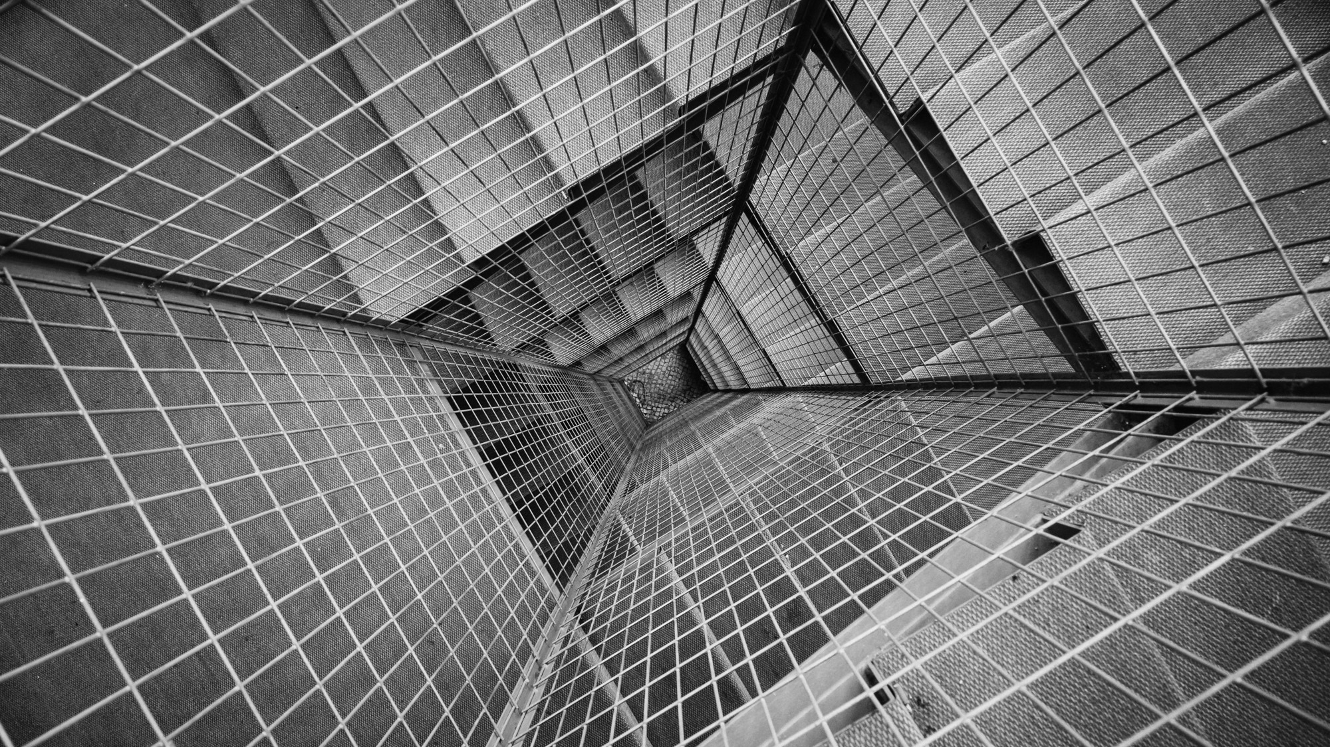
TOTAL TECHNOLOGY
REPORTLAB COMPLETE TUTORIAL
PARAGRAPH inline image MaRKUP
Part 22

Slide 2
How to add inline image in paragraph
#tutorial 22
#inline image in paragraph
from reportlab.platypus import Paragraph,SimpleDocTemplate
from reportlab.lib.styles import getSampleStyleSheet
pdf=SimpleDocTemplate("tutorial22.pdf")
flow_object=[]
styles=getSampleStyleSheet()
text='''
this is our logo <img src="logo.jpg" width="50" height="50"/>,hope you guys like it.
'''
p_text=Paragraph(text,style=styles["Normal"])
flow_object.append(p_text)
pdf.build(flow_object)
TOTAL TECHNOLOGY

Slide 3
How to append multile paragraph with inline image
#tutorial 22
#inline image in paragraph
from reportlab.platypus import Paragraph,SimpleDocTemplate
from reportlab.lib.styles import getSampleStyleSheet
pdf=SimpleDocTemplate("tutorial22.pdf")
flow_object=[]
styles=getSampleStyleSheet()
styles["Normal"].spaceAfter=40
text='''
this is our logo <img src="logo.jpg" width="50" height="50"/>,hope you guys like it.
'''
p_text=Paragraph(text,style=styles["Normal"])
flow_object.append(p_text)
text='''
next paragraph with our logo ,<img src="logo.jpg" width="50" height="50"/>.
'''
p_text=Paragraph(text,style=styles["Normal"])
flow_object.append(p_text)
pdf.build(flow_object)
TOTAL TECHNOLOGY

Slide 4
Uses of spaceafter
To create space between the end of one paragraph we use this attribute .
TOTAL TECHNOLOGY

